Slide 1
Unified Interface Mobile
Linda Simovic
Principal Group Program Manager

Slide 2
Attention: PLEASE READ
Photography and copyright infringement.
Using imagery from movies, television, music and pop-culture is illegal, unless purchased, licensed or by express written consent from the owner. Please do not include unlicensed imagery in your presentation.
Sessions with questionable imagery will not be published until resolved. The speaker will be contacted via email for immediate resolution. If additional costs are incurred in editing, an I/O Code will be required.
If you have any questions regarding your imagery please contact
Media Acquisitions
Music Sound Video Acquisitions: musovid@microsoft.com.
The PPT deck and Recording will not be published until the editing is complete.

Slide 3
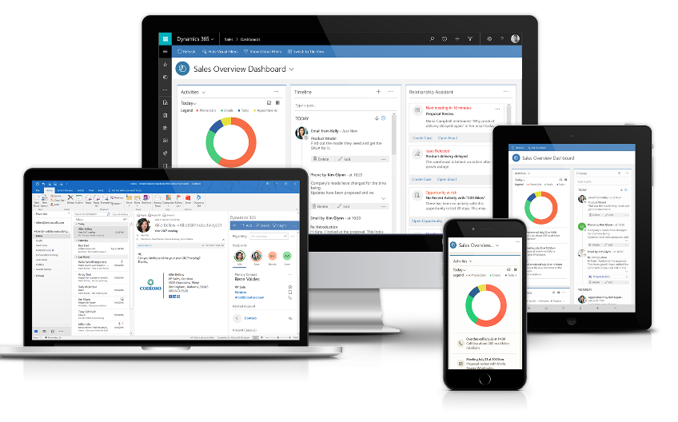
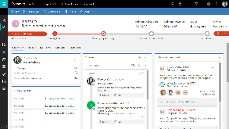
Unified Interface
Next Generation User Experience Optimized for Business

Slide 4
Unified Interface Benefits
Reusability
Develop once, deploy where you want
Mobile First
Always available, quick access, secure
Smart
Intelligent and based on AI
In context
Surface the right things in the right places
Empowering
Access to the entire CRM on the go
Reuse existing great functionality like Task Flows and Dashboards
One Client deep reflow, cross OS
Built from the ground up based on UX best practices.
Full offline support
Fast to open, fast to navigate
Enterprise level security, MAM and NAM support
Embedded AI
Assistant help
Recommended actions
Drive efficiency based on app-to-app integration
Office and the native device capabilities
One set of capabilities across devices
Support for full continuum scenarios
Preserve last visited records, favorites across web and mobile

Slide 5
Custom Controls and App Modules

Slide 6
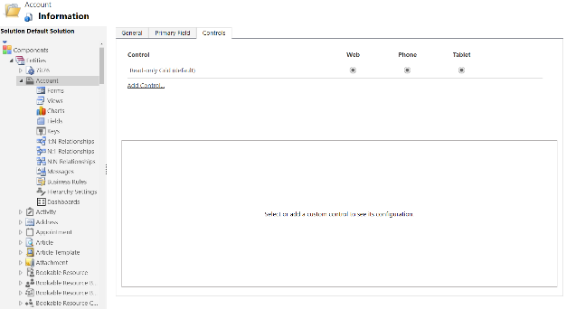
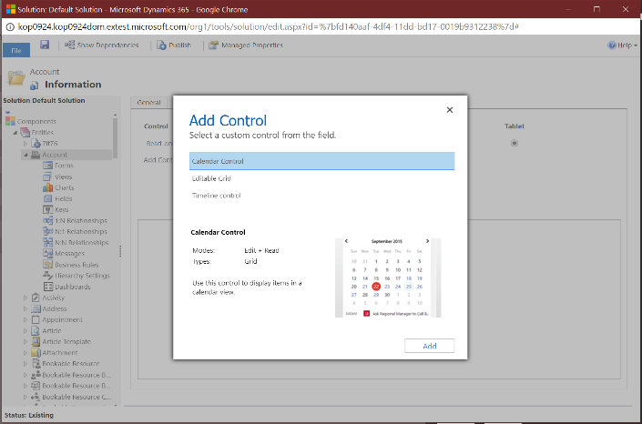
Custom Controls

Slide 7
Custom Control Framework
  Extensibility framework for building UI components that visualize data.
Extend
Visualize
Portable
Metadata Driven
Configurable
Reusable
Field Data
Dataset Data
Unbound Controls
Solution Aware
Configurable
Responsive

Slide 8

Why Custom controls?
Multiple form factor support
Responsive, Adaptable, and reusable
Life Cycle Management
Seamless Upgrades, Customizability, Data Integration
Built for Expansion
TBX/MDD Support, Client API integration, Accessibility, Performance

Slide 9

What makes a custom control?
Manifest
Implementation
Resources
An XML File that defines the control
JavaScript Objects
For building
Name and version
Field and Dataset Properties
Resources
Implement the custom control interface
Javascript Libraries, CSS, Images
Packaged and Installed as standard CRM solutions

Slide 10

Custom Controls
Potassium
All OOB controls on UCI are built on CCF
  Business Edition Sales, Business Edition Marketing, Customer Service Hub, and Mobile
Solution awareness for controls
Preview Feature first : Documentation and exposing of a rich set of CCF APIs as developer experience to external developers\partners.

Slide 11

Custom Controls
Looking Forward
Control Gallery
  View controls in the marketplace and purchase solutions
Make OOB controls source available as sample controls
  Customizers can modify the OOB implementations
CRM controls styling shared via ready to use CSS/classes
  No more raw theming values
In App customization experience
  Drag and drop custom controls.
  Edit the properties and compose
In App development experience
  XML based design language for creating controls.
  Slug support in the control to query server

Slide 12
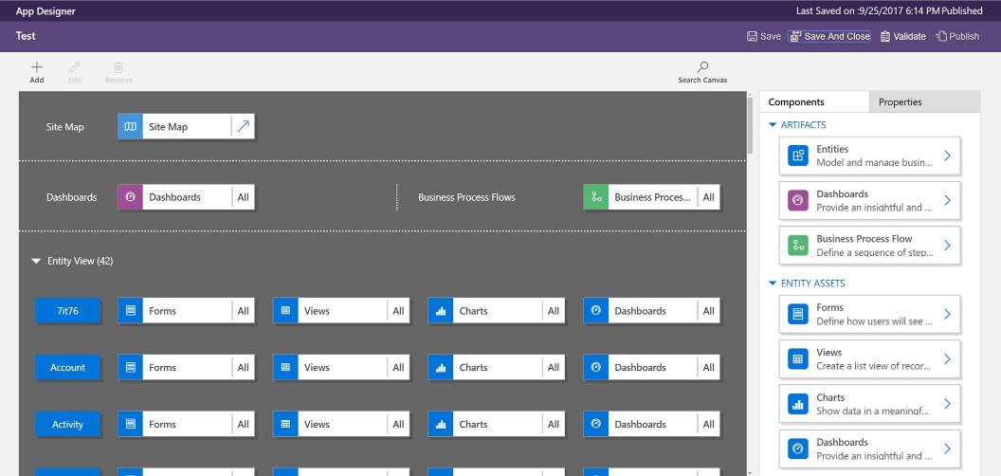
App Modules
Carve out entities for a focused experience

Slide 13
Mobile Features

Slide 14
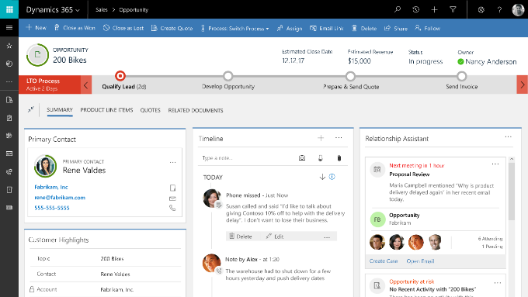


Reflow

Slide 15
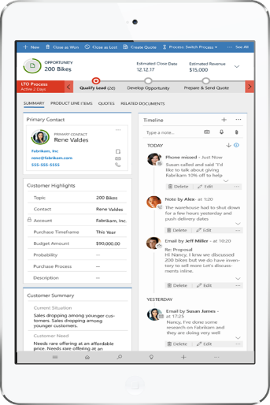
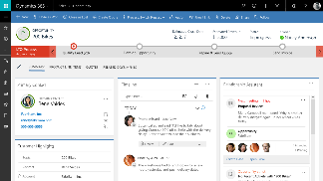
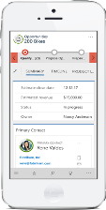
Reflow

Slide 16
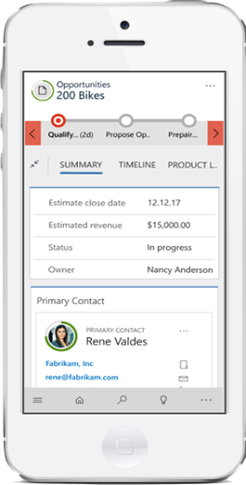
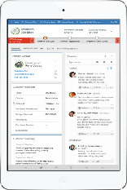

Reflow

Slide 17

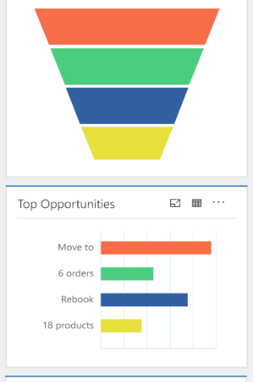
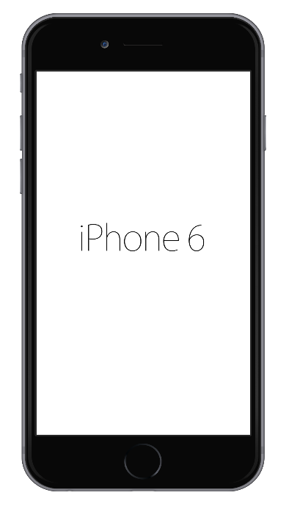
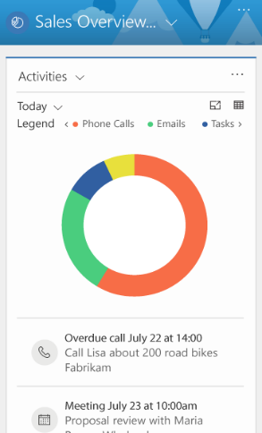

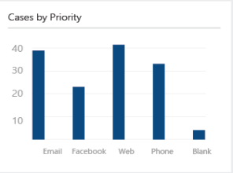
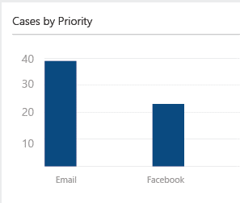

Dashboards
See details using Touch Tooltips
Focus on key data using Pinch to zoom Chart
Key Phone Calls 10
Integrated Chart and List

Slide 18
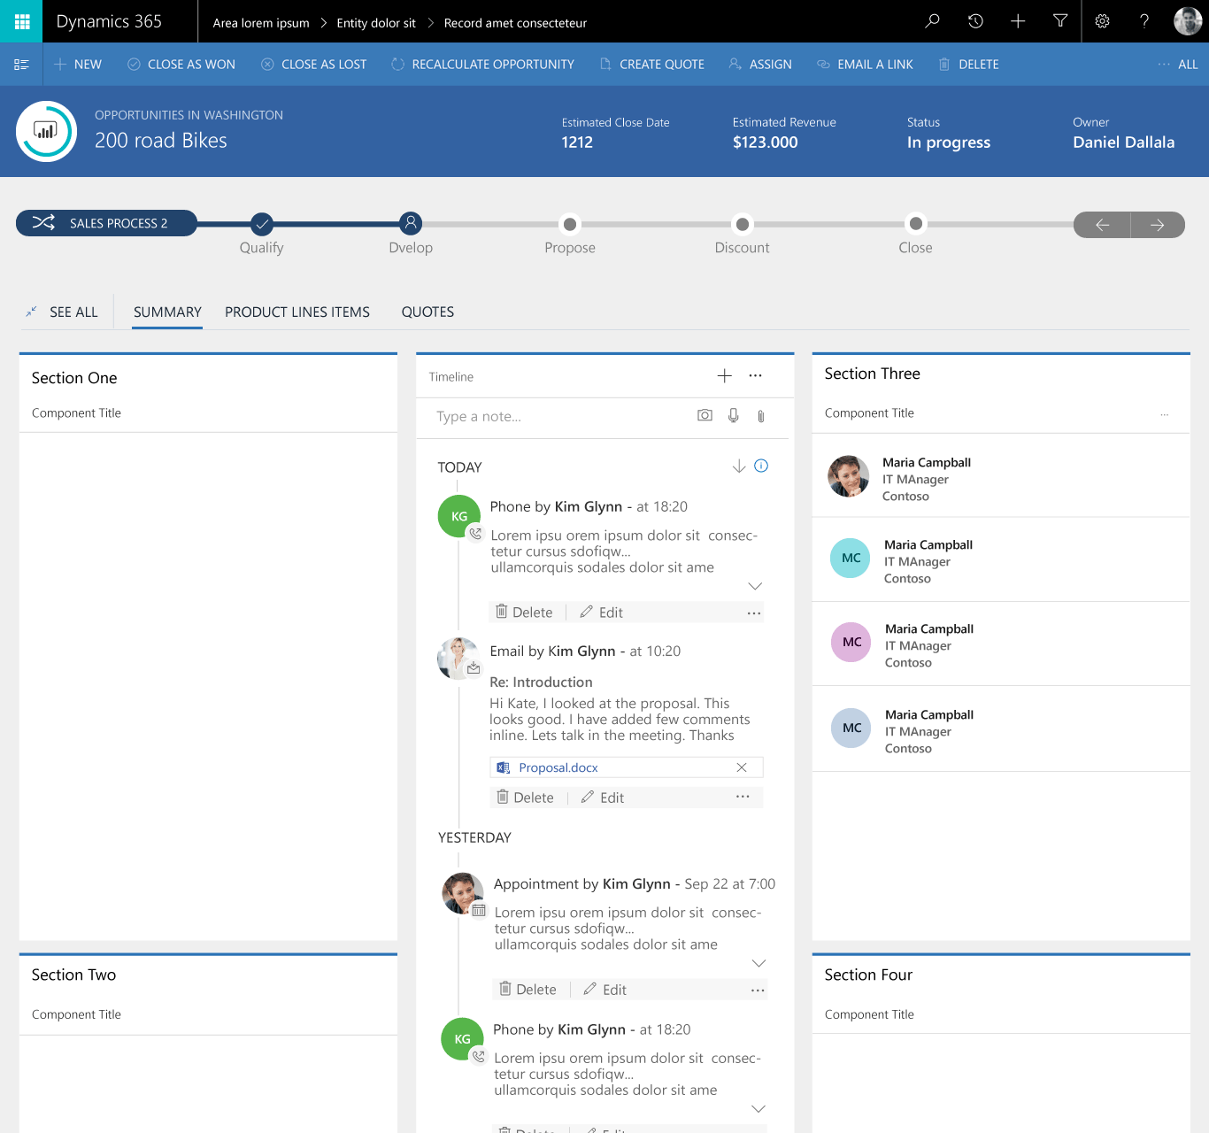
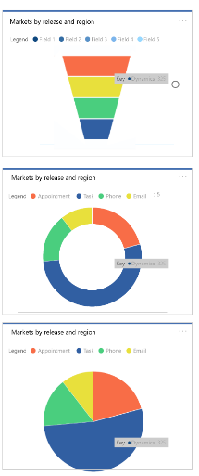
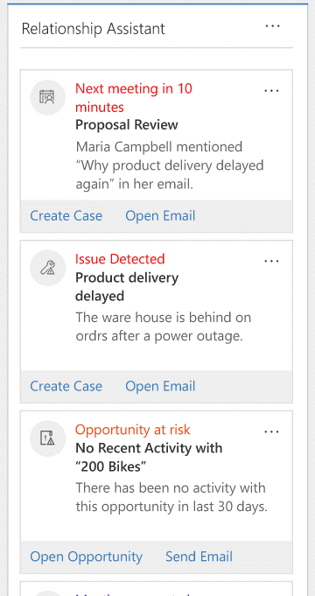
New Charts new controls on mobile
More Chart types
Activity Timeline
Relationship Assistant

Slide 19

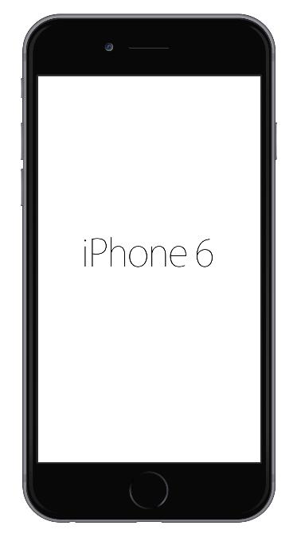

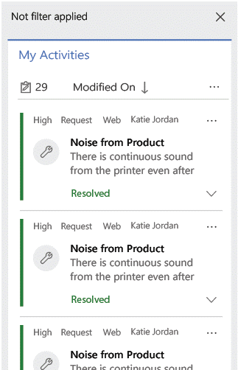
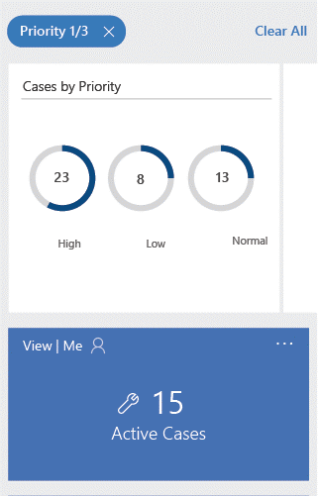
Interactive Dashboard
Visual filters to focus on key cases
Drill into steam list with data dense card forms

Slide 20
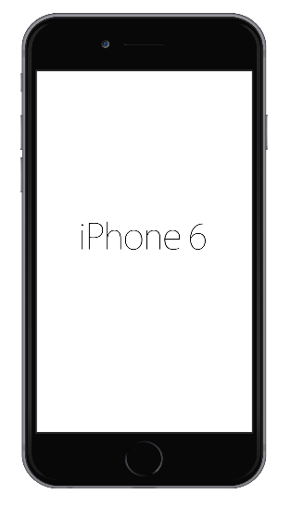
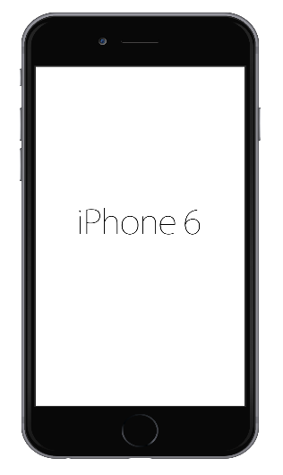

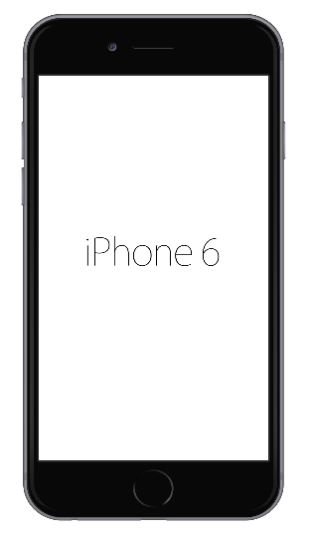
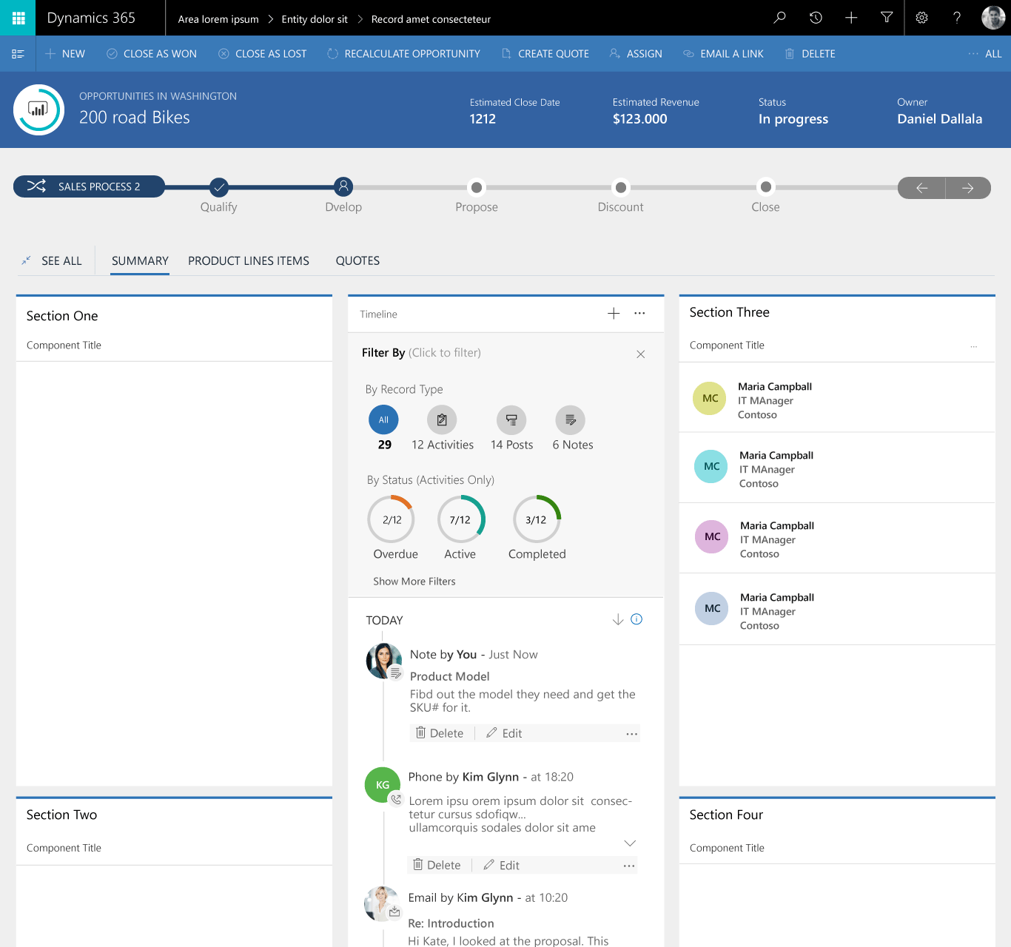

Timeline
Combined view of Posts, Activities and Notes
Visual filters to slice and dice the activities
Catch up quickly with What you missed

Slide 21
Dashboard & Timeline Demo

Slide 22
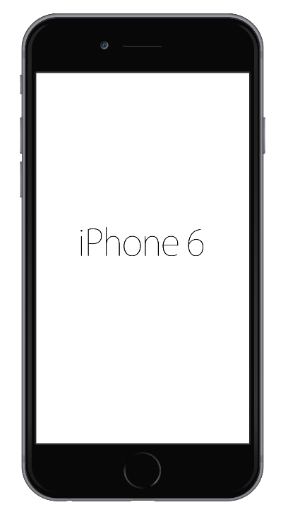
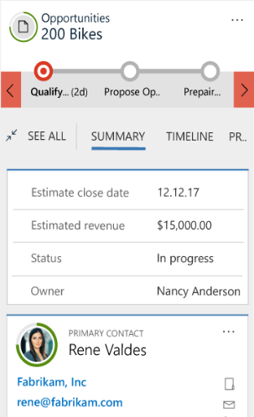
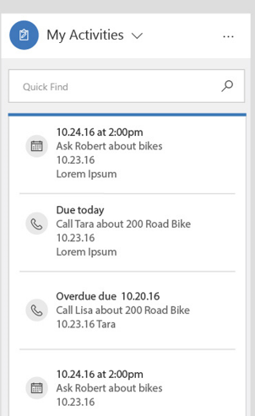
Forms and Navigation
Bike
Switch between forms
Quickly navigate to tabs on the form
Full Quick View forms and card layout
Notes:
User efficency
Tab selector
Semantic zoom
Form selector (multiple forms)
Record set navigation
Visualization
Quick View forms
Timeline control
Responsive layout
Capabilities
Removed limits:75 fields, 10 subgrid and tabs

Slide 23
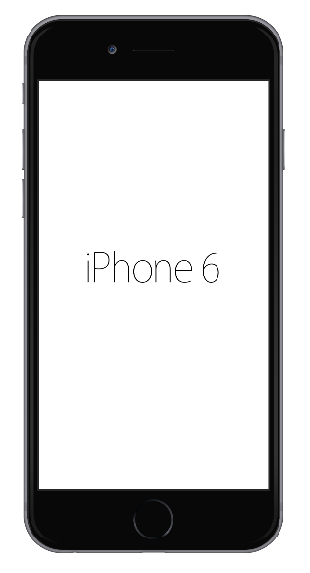
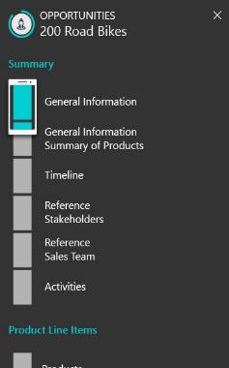
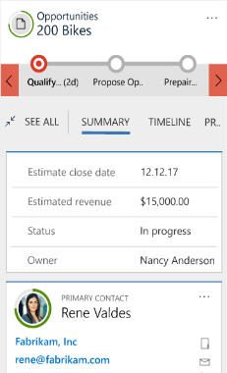

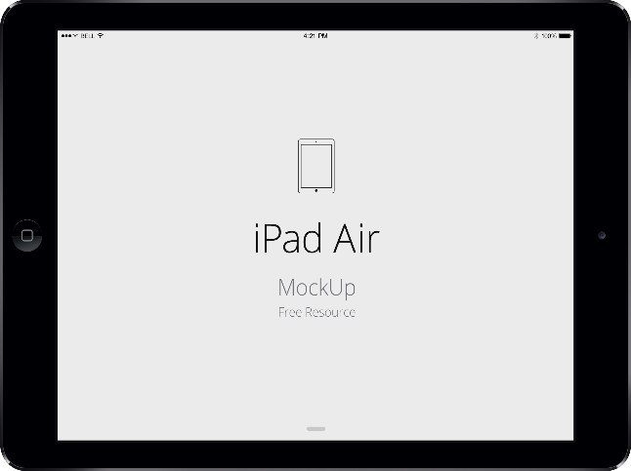

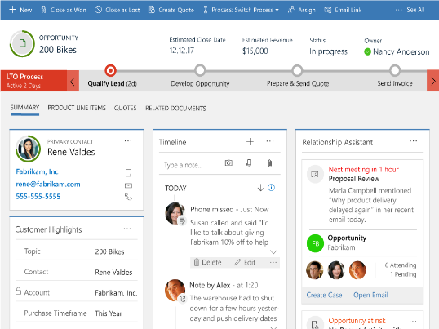
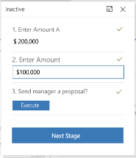
Forms Navigation
Bike
Birds eye view with semantic zoom
Jump directly to any section
Record set navigation to quickly move through records
Notes:
User efficency
Tab selector
Semantic zoom
Form selector (multiple forms)
Record set navigation
Visualization
Quick View forms
Timeline control
Responsive layout
Capabilities
Removed limits:75 fields, 10 subgrid and tabs

Slide 24
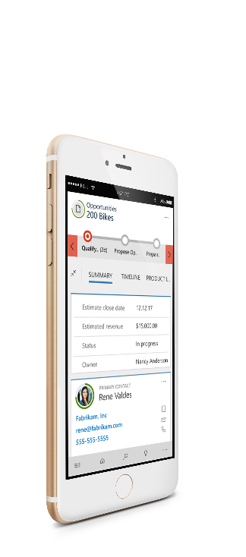
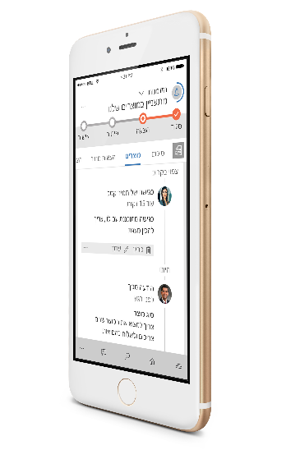
Native RTL support across all surfaces

Slide 25

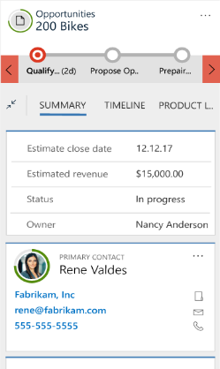
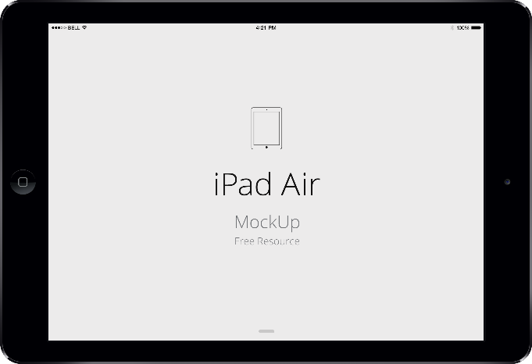


Business process
Quickly identify process progression
Easily see how long you are in stage
Process steps as a flyout or docked for tablet.

Slide 26

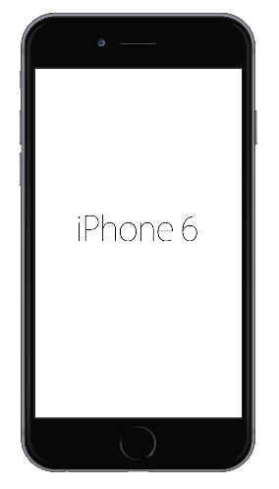


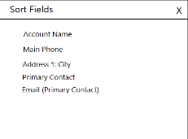

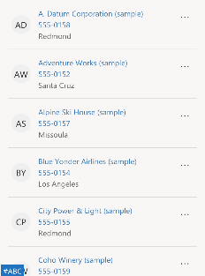
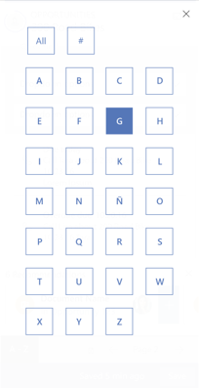
Easy dataset interactions
Easily change views and access commands
Quickly find records with inline find
Quickly jump ahead in a list with one handed navigation
Sort by any field in the view

Slide 27
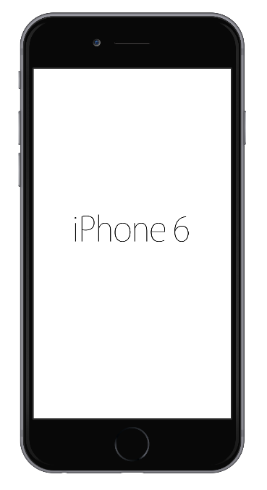

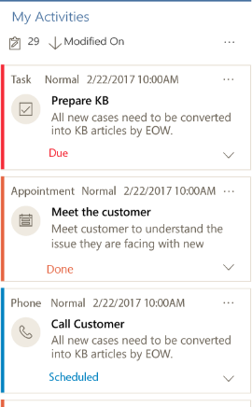
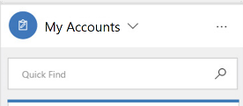

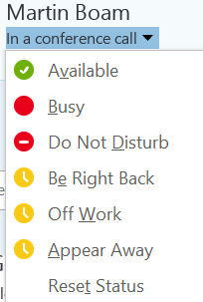
Rich data visualizations
With conditional images users have visual cues to make informed decisions.
Use Card Forms to present data in configurable layout
Expand to show more info without navigating

Slide 28

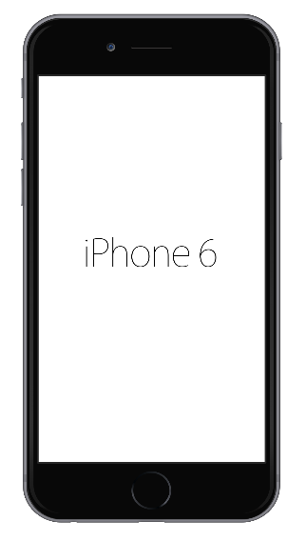
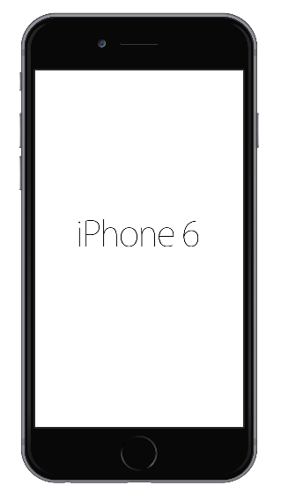
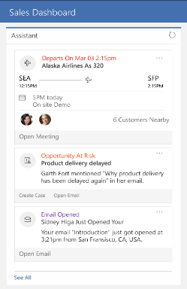











Assistant and recommendation
Assistant
Embedded in forms and dashboards for in context recommendation
Available globally so you can get to it quickly
Use recommendations carousel to add relevant documents

Slide 29








New sitemap, easy navigation
Full Sitemap available on mobile
User Centered Interactions – New Site Map
Easily switch apps
Quick Access to Favorites and Recent
Build focused applications
Notes:
Sitemap
Look and feel
Full sitemap
Favorites and Recent
App Switching
Navigation Bar
Look and feel
Relationship Assistant
In app toast notifications

Slide 30
Tablet + Phone Demos

Slide 31
Q&A

Slide 32
Demo Screenshots

Slide 33


Slide 34


Slide 35


Slide 36


Slide 37


Slide 38


